Slide 1

Unit 1 – Introduction to Identity Theft
NOTIFICATIONS – PLEASE READ
The training information provided as part of these lessons is solely for reference purposes only, and should not be relied upon in any respect as totally accurate information. Any opinions, statements, or other information or content expressed or made available in any exert by any third party are those of the respective author(s) or distributor(s) and are not those of the ORCPI. ORCPI cannot be held responsible for the accuracy of their information.
The Oklahoma Regional Community Policing Institute
ORCPI
PO Box 6362
Norman, OK 73072-6362

Slide 2

Unit 1 – Introduction to Identity Theft
Hello and welcome!
Unit 1 will introduce you to some important definitions in the world of identity theft. It will also give you an overview of the of some topics we will explore in detail in future units.

Slide 3

Unit 1 – Introduction to Identity Theft
And they could use them to:
buy things with your credit cards
get new credit cards in your name
open a phone, electricity, or gas account in your name
steal your tax refund
use your health insurance to get medical care
pretend to be you if they are arrested
…and much more!
What is Identity Theft?
Identity theft is when someone uses your personal or financial information without your permission. They might steal your name and address, credit card, or bank account numbers, Social Security number, or medical insurance account numbers.

Slide 4
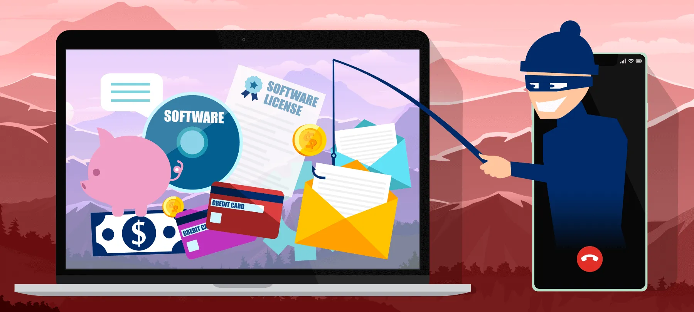
Unit 1 – Introduction to Identity Theft
Identity Theft vs. Identity Fraud
Though sometimes used interchangeably, identity theft and identity fraud are two different things. Identity theft is when a victim’s Personal Identifying Information (PII) is stolen. Stolen PII could include the victim’s name, address, Social Security number, or other identifying numbers such as medical insurance or credit card accounts. Identity fraud occurs when thieves use that information for illicit gain.

Slide 5

Unit 1 – Introduction to Identity Theft
The Federal Trade Commission (FTC) sees identity fraud and the schemes used to commit them, as federal offenses:
Identification fraud
Credit card fraud
Computer fraud
Mail fraud
Wire fraud
Financial Institution fraud

Slide 6

Unit 1 – Introduction to Identity Theft
In fraud cases, Federal Prosecutors work with many other law enforcement related agencies:
Federal Trade Commission (FTC)
Federal Bureau of Investigation (FBI)
United States Secret Service
U. S. Postal Inspection Service

Slide 7
Unit 1 – Introduction to Identity Theft
Identity Theft Categories
Although identity theft takes many forms, there are some important major categories that a large portion of identity theft falls into. Let’s explore these categories in a more in-depth way.

Slide 8

Unit 1 – Introduction to Identity Theft
Financial Identity Theft
Credit card fraud tops the list of identity theft crimes and some experts estimate that over 80 percent of credit cards currently in people’s wallets have already been compromised. Thieves may open new accounts and they can be difficult to detect. The most common types of new accounts that scammers open are online accounts such as eBay or Amazon, checking or savings accounts, and credit card accounts.

Slide 9
Unit 1 – Introduction to Identity Theft
Financial Identity Theft
While microchips in credit cards have reportedly helped curb in-store fraud, experts say that mobile and online transactions are now the low-hanging fruit. As a result, card-not-present fraud, a scam in which the credit card is not physically used such as for online or phone transactions, has ballooned in recent years.

Slide 10

Unit 1 – Introduction to Identity Theft
Tax Identity Theft
Thieves aim to file a fake tax return before the victim does. According to the IRS, tax-related identity theft is one of the most common tax scams. Tax identity theft occurs when a criminal uses the victim’s Social Security number to file a fraudulent tax return. Victims may not know the crime has happened until the IRS rejects their tax return as a duplicate filing.

Slide 11
Unit 1 – Introduction to Identity Theft
Tax Identity Theft
Experts recommend filing taxes early. The IRS accepts only one tax return per Social Security number, so if a taxpayer can file their authentic tax return before a potential criminal can file their fraudulent one, they may be able to beat an identity thief to the punch. On the other hand, if a criminal succeeds in filing their fraudulent return first, it could take months for the victim to resolve the issues.

Slide 12

Unit 1 – Introduction to Identity Theft
Medical Identity Theft
Medical identity theft is when a criminal submits fraudulent claims to the victim’s health insurance or Medicare or uses the victim’s information to get treatment, prescription drugs, medical devices, or other benefits. It can lead to tens of thousands of dollars in damages.

Slide 13
Unit 1 – Introduction to Identity Theft
Medical Identity Theft
Medical identity theft is one of the most difficult types of identity theft to repair, and it can cost far more than financial identity theft. Federal law generally limits consumers’ liability for fraudulent credit card charges to $50, but there are no such protections for a stolen medical identity.

Slide 14

Unit 1 – Introduction to Identity Theft
Employment Identity Theft
In employment identity theft cases, scammers may file fraudulent unemployment claims, or alternatively, they may use a falsified or stolen ID to get a job using the victim’s identity. Victims may learn of employment fraud when their employer asks why they have applied for jobless benefits or receive a W-2 or 1099 from an unfamiliar employer.

Slide 15

Unit 1 – Introduction to Identity Theft
Child Identity Theft
Many parents assume that their children are safe from identity theft because of their young age and lack of credit history. However, for identity thieves, children can be the perfect mark. While thieves may target adults for the money in their accounts, a child represents a clean slate for opening new lines of credit.

Slide 16
Unit 1 – Introduction to Identity Theft
Child Identity Theft
The identity theft of a child can go undetected for years—or even decades. And the consequences can be devastating. When the child becomes a young adult and seeks independence, they may have problems with banks, landlords, utility companies, and potential employers due to their negative credit history.

Slide 17

Unit 1 – Introduction to Identity Theft
Criminal Identity Theft
Though rare, criminal identity theft can occur when someone cited or arrested for a crime uses the victim’s name and identifying information, resulting in a criminal record in the victim’s name. Criminals may steal a victim’s identity to commit a crime, enter a country, get special permits, hide their own identity, or commit acts of terrorism.

Slide 18
Unit 1 – Introduction to Identity Theft
Criminal Identity Theft
Victims may be unaware they have a criminal record. An identity thief, using the victim’s name or personal information, may sign a citation or be required to appear in court. When neither thief nor victim appear in court, the judge may issue an arrest warrant, or a criminal record may be created in the victim’s name.

Slide 19
Unit 1 – Introduction to Identity Theft
Clues That Someone Has Stolen Your Identity
It is often very difficult to know if someone has stolen your identity while it is happening. Many times, there is a delay in the victim understanding what has happened. Let’s look at some clues and warning signs that someone may have stolen your identity

Slide 20
Unit 1 – Introduction to Identity Theft
Clues That Someone Has Stolen Your Identity
You see withdrawals from your bank account that you can not explain.

Slide 21
Unit 1 – Introduction to Identity Theft
Clues That Someone Has Stolen Your Identity
You see withdrawals from your bank account that you can not explain.
You do not get your bills or other mail.

Slide 22
Unit 1 – Introduction to Identity Theft
Clues That Someone Has Stolen Your Identity
You see withdrawals from your bank account that you can not explain.
You do not get your bills or other mail.
Merchants refuse your checks.

Slide 23
Unit 1 – Introduction to Identity Theft
Clues That Someone Has Stolen Your Identity
You see withdrawals from your bank account that you can not explain.
You do not get your bills or other mail.
Merchants refuse your checks.
Debt collectors call you about debts that are not yours.

Slide 24
Unit 1 – Introduction to Identity Theft
Clues That Someone Has Stolen Your Identity
You see withdrawals from your bank account that you can not explain.
You do not get your bills or other mail.
Merchants refuse your checks.
Debt collectors call you about debts that are not yours.
You find unfamiliar accounts or charges on your credit report.

Slide 25
Unit 1 – Introduction to Identity Theft
Clues That Someone Has Stolen Your Identity
You see withdrawals from your bank account that you can not explain.
You do not get your bills or other mail.
Merchants refuse your checks.
Debt collectors call you about debts that are not yours.
You find unfamiliar accounts or charges on your credit report.
Medical providers bill you for services you didn’t use.

Slide 26
Unit 1 – Introduction to Identity Theft
Clues That Someone Has Stolen Your Identity
You see withdrawals from your bank account that you can not explain.
You do not get your bills or other mail.
Merchants refuse your checks.
Debt collectors call you about debts that are not yours.
You find unfamiliar accounts or charges on your credit report.
Medical providers bill you for services you didn’t use.
Your health plan rejects your legitimate medical claim because the records show you have reached your benefits limit.

Slide 27
Unit 1 – Introduction to Identity Theft
Clues That Someone Has Stolen Your Identity
You see withdrawals from your bank account that you can not explain.
You do not get your bills or other mail.
Merchants refuse your checks.
Debt collectors call you about debts that are not yours.
You find unfamiliar accounts or charges on your credit report.
Medical providers bill you for services you didn’t use.
Your health plan rejects your legitimate medical claim because the records show you have reached your benefits limit.
A health plan will not cover you because your medical records show a condition you don’t have.

Slide 28
Unit 1 – Introduction to Identity Theft
Clues That Someone Has Stolen Your Identity
You see withdrawals from your bank account that you can not explain.
You do not get your bills or other mail.
Merchants refuse your checks.
Debt collectors call you about debts that are not yours.
You find unfamiliar accounts or charges on your credit report.
Medical providers bill you for services you didn’t use.
Your health plan rejects your legitimate medical claim because the records show you have reached your benefits limit.
A health plan will not cover you because your medical records show a condition you don’t have.
The IRS notifies you that more than one tax return was filed in your name, or that you have income from an employer you don’t work for.

Slide 29
Unit 1 – Introduction to Identity Theft
Clues That Someone Has Stolen Your Identity
You see withdrawals from your bank account that you can not explain.
You do not get your bills or other mail.
Merchants refuse your checks.
Debt collectors call you about debts that are not yours.
You find unfamiliar accounts or charges on your credit report.
Medical providers bill you for services you didn’t use.
Your health plan rejects your legitimate medical claim because the records show you have reached your benefits limit.
A health plan will not cover you because your medical records show a condition you don’t have.
The IRS notifies you that more than one tax return was filed in your name, or that you have income from an employer you don’t work for.
You get notice that your information was compromised by a data breach at a company where you do business or have an account.

Slide 30
Unit 1 – Introduction to Identity Theft
How To Report An Incident
When you become the victim of identity theft, where to start can be a confusing situation to find yourself in. Here are some things you should do right away.

Slide 31

Unit 1 – Introduction to Identity Theft
What to do right away if you are the victim of identity theft:
Call the fraud department of the company where the fraud occurred. Explain that someone stole your identity. Ask them to close or freeze the accounts. Then, no one can add new charges unless you agree.

Slide 32
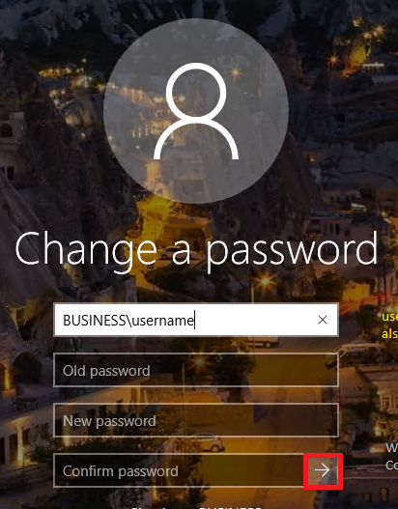
Unit 1 – Introduction to Identity Theft
What to do right away if you are the victim of identity theft:
Call the fraud department of the company where the fraud occurred. Explain that someone stole your identity. Ask them to close or freeze the accounts. Then, no one can add new charges unless you agree.
Change logins, passwords, and PINs for all your accounts

Slide 33
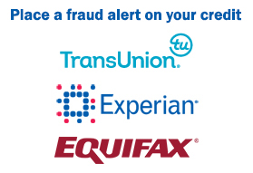
Unit 1 – Introduction to Identity Theft
What to do right away if you are the victim of identity theft:
Place a free fraud alert with one of the three credit bureaus. That company must tell the other two.
  Experian.com/help, 888-EXPERIAN (888-397-3742)
  TransUnion.com/credit-help, 888-909-8872
  Equifax.com/personal/credit-report-services 800-685-1111
Get updates at IdentityTheft.gov/creditbureaucontacts.
Get your free credit reports from Equifax, Experian, and TransUnion and review them thoroughly. Go to annualcreditreport.com or call 1-877-322-8228.

Slide 34

Unit 1 – Introduction to Identity Theft
What to do right away if you are the victim of identity theft:
Go to IdentityTheft.gov and include as many details as possible. Based on the information you enter, IdentityTheft.gov will create your Identity Theft Report and recovery plan.

Slide 35

Unit 1 – Introduction to Identity Theft
What to do right away if you are the victim of identity theft:
For possible tax identity theft, the IRS recommends responding immediately to any IRS notice. If an e-filed return was rejected because of a duplicate filing, or if the IRS instructs you to do so, complete IRS Form 14039, Identity Theft Affidavit (PDF).

Slide 36

Unit 1 – Introduction to Identity Theft
What to do right away if you are the victim of identity theft:
For possible medical identity theft, the US Department of Health and Human Services recommends contacting their fraud hotline and the Medicare.gov web page on reporting fraud.

Slide 37
Unit 1 – Introduction to Identity Theft
Unit 1 Conclusion
This concludes our presentation; Introduction to Identity Theft. You should now have a solid understanding of the fundamentals of identity theft.
Click for Unit 1 Quiz

