Slide 1

Unit 1 – Introduction to the Oklahoma Graduated Driver License Program
NOTIFICATIONS – PLEASE READ
The training information provided as part of these lessons is solely for reference purposes only and should not be relied upon in any respect as totally accurate information. Any opinions, statements, or other information or content expressed or made available in any exert by any third party are those of the respective author(s) or distributor(s) and are not those of the ORCPI. ORCPI cannot be held responsible for the accuracy of their information.
The Oklahoma Regional Community Policing Institute
ORCPI
PO Box 6362
Norman, OK 73072-6362

Slide 2
Unit 1 – Introduction to the Oklahoma Graduated Driver License Program
Unit 1
Introduction to the
Oklahoma Graduated Driver License (GDL) Program
The Oklahoma Regional Community Policing Institute
ORCPI
PO Box 6362
Norman, OK 73072-6362

Slide 3
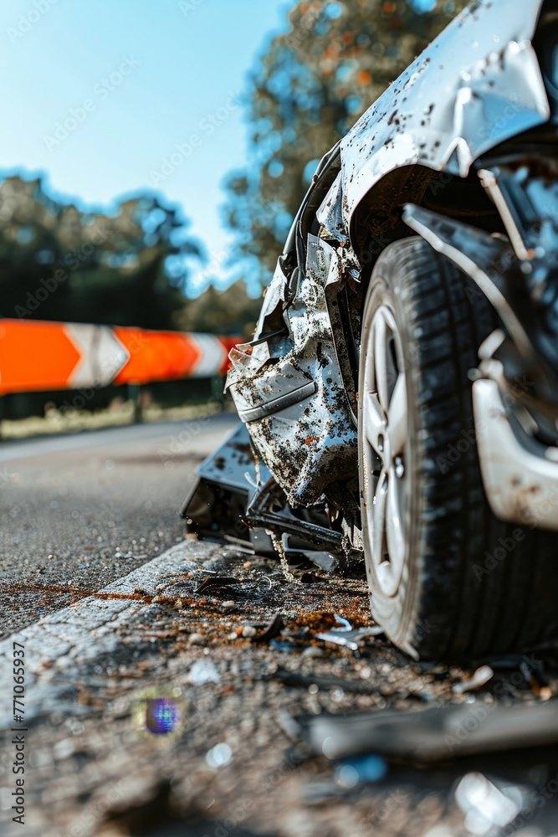
Unit 1 – Introduction to the Oklahoma Graduated Driver License Program
Oklahoma’s GDL Program – The Why
Motor vehicle crashes are the number one cause of preventable death for teens and young drivers (15-20 years old) in Oklahoma and the US.
In 2023, the National Highway Traffic Safety Administration (NHTSA) estimates:
there were 2,148 teens, aged 15-20, killed in motor vehicle crashes, averaging almost 6 teen fatalities per day!
An additional estimated 180,209 young drivers were injured!
The rate of young male drivers killed was almost 3 times higher than young female drivers.
64% of the passengers killed in vehicles driven by another teenager were also 15 to 20 years old.
54% of young drivers killed were not wearing a seat belt!

Slide 4
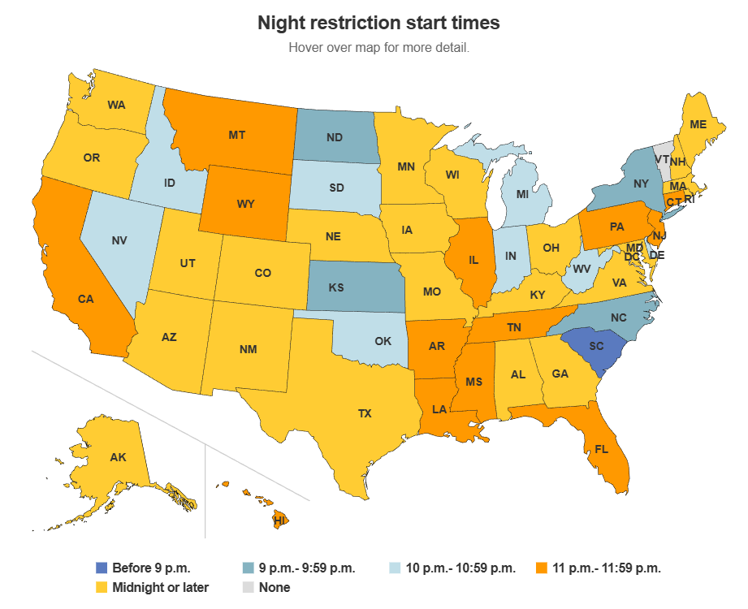
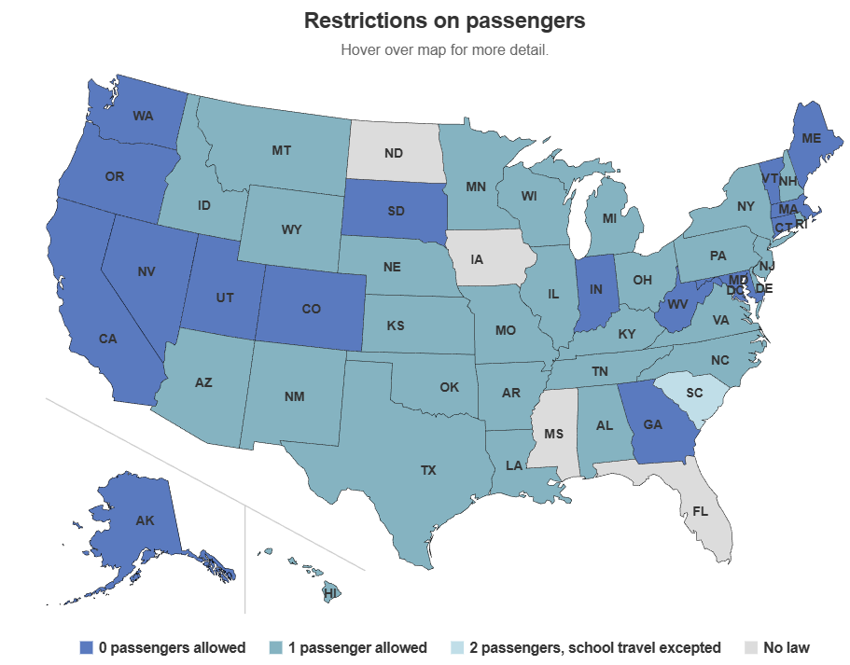
Unit 1 – Introduction to the Oklahoma Graduated Driver License Program
Oklahoma’s GDL Program – The Why
According to the Insurance Institute for Highway Safety (IIHS), both age and experience are strong factors in teen drivers’ crash risk. Common characteristics of teens’ fatal crashes include driver error, speeding, single-vehicle crashes, number, gender and age of passengers, and nighttime driving.
Graduated Driver Licensing (GDL) has been implemented in some form in every US state, including Oklahoma. This countermeasure provides the opportunity for teens to gain meaningful driving experience under supervised conditions.
Graduated Driver License programs have shown to be extremely effective in reducing traffic related deaths and injuries among young drivers.

Slide 5
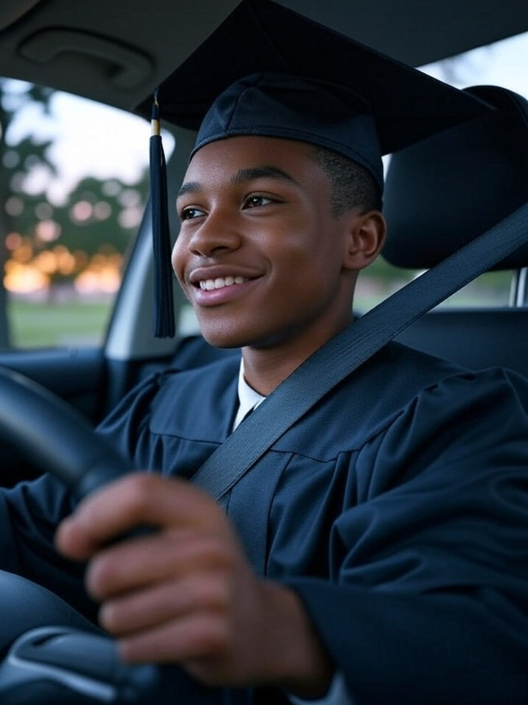
Unit 1 – Introduction to the Oklahoma Graduated Driver License Program
Igniting Safe Journeys with Oklahoma’s GDL Program
Buckle up for a transformative journey through Oklahoma’s Graduated Driver License (GDL) program—a dynamic system designed to empower our young drivers with the skills, confidence, and responsibility needed to navigate the open road safely!
This innovative program phases in driving privileges, guiding teens from supervised practice to independent freedom while prioritizing safety at every turn.
By fostering experience and accountability, the GDL program doesn’t just create drivers—it builds a generation of road-ready stewards, ready to steer Oklahoma’s highways with care and precision.
Let’s dive into how this program is shaping safer roads and brighter futures!

Slide 6

Unit 1 – Introduction to the Oklahoma Graduated Driver License Program
Oklahoma’s GDL Program. A Big Success Story.
The Oklahoma Graduated Driver License (GDL) program has been successful in fostering safer roads and protecting young drivers since its inception in 1999, with significant enhancements in 2005 through House Bill 1653.
By phasing in driving privileges through a structured system—starting with a learner permit, progressing to an intermediate license, and culminating in an unrestricted license—the GDL ensures teens gain critical experience under controlled conditions.
The GDL’s restrictions address the high-risk behaviors of young drivers, whose inexperience and impulsivity often contribute to collisions.
Oklahoma’s commitment to driver education, including mandatory courses and the innovative Work Zone Safe Course, further equips teens with the skills to navigate complex road environments.
By cultivating responsibility and prioritizing safety, the GDL program not only saves lives but also instills lifelong safe driving habits, making Oklahoma’s roads safer for everyone.

Slide 7
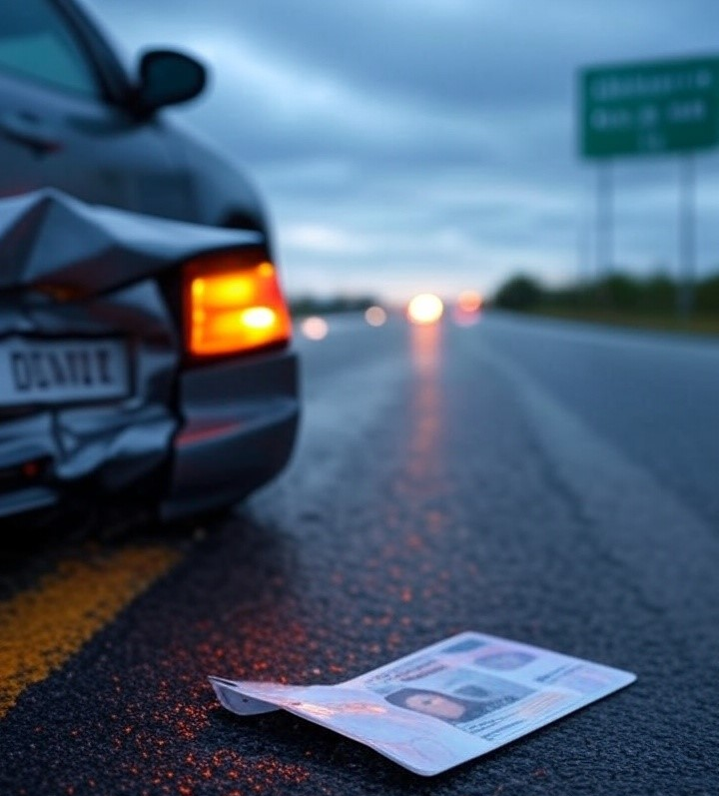
Unit 1 – Introduction to the Oklahoma Graduated Driver License Program
Driving is dangerous.
GDL is mission critical.
Driving is a privilege that comes with immense responsibility, as the open road can swiftly turn from a path of freedom to a stage for tragedy. Each year, thousands of lives are lost or forever altered due to car crashes, with young, inexperienced drivers disproportionately at risk—teen drivers are nearly three times more likely to be involved in a fatal crash than those over 20.
The Oklahoma Graduated Driver License (GDL) program is not just a set of rules; it’s a lifeline, a mission-critical shield designed to protect our youth and communities.
By phasing in driving privileges—like limiting nighttime driving and number of passengers—GDL builds skills gradually, reducing the reckless confidence that often leads to disaster.
This program is a proven protector, cutting teen crash rates by up to 40% in states with robust systems. Without GDL, we’re gambling with lives, leaving our kids vulnerable to the split-second mistakes that can’t be undone.
Oklahoma’s GDL is a call to action, a commitment to safety over convenience, ensuring our drivers grow into the responsibility they wield behind the wheel.

Slide 8
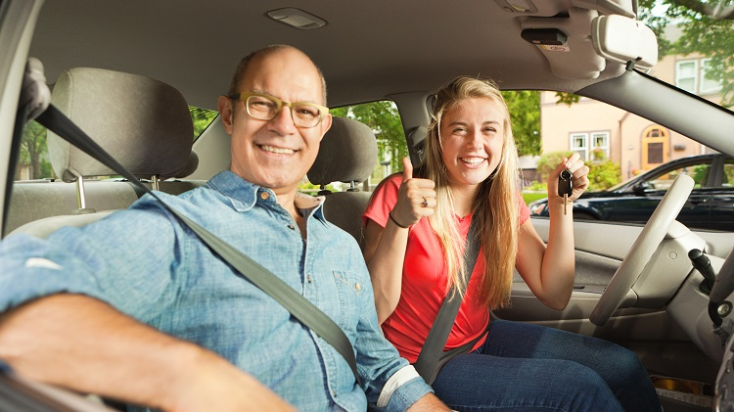
Unit 1 – Introduction to the Oklahoma Graduated Driver License Program
Parents value GDL
The Oklahoma Graduated Driver License (GDL) program is a vital lifeline for parents, offering a structured path to guide teens toward safe, confident driving.
This program isn’t just a set of rules—it’s a shield, protecting young drivers by phasing in privileges through supervised practice, restricted hours, and passenger limits.
With 25% of 16-year-old drivers facing crashes or violations in their first year, the GDL’s deliberate approach reduces risks, giving teens time to master skills under real-world conditions while easing parental fears.
By fostering responsible habits and encouraging active parental involvement, the GDL empowers parents and families to shape skilled, cautious drivers, ensuring their kids come home safely every night.
Parents:
Embrace and champion GDL as a proven partner in safeguarding your teens’ lives and futures.​

Slide 9
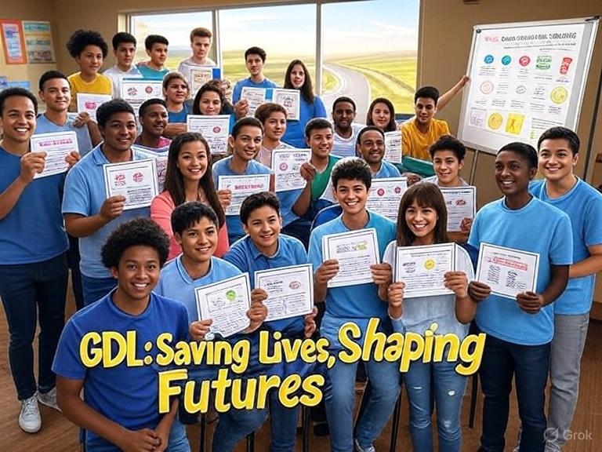
Unit 1 – Introduction to the Oklahoma Graduated Driver License Program
Teachers value GDL
The Oklahoma Graduated Driver License (GDL) program is not just a regulatory framework—it’s a vital support system that helps protect our teens and strengthen community safety. It’s important for teachers to help promote and reinforce it.
By phasing in driving privileges through structured stages—Learner Permit, Intermediate License, and Unrestricted License—GDL ensures young drivers gain critical experience under controlled conditions, significantly reducing the risk of crashes, which are the leading cause of death for teens.
As educators, you shape responsible citizens; supporting GDL means empowering students with the skills and judgment to navigate roads safely, protecting their lives and those around them.
This program is mission-critical because it transforms impulsive, inexperienced teens into confident, cautious drivers, fostering a culture of responsibility that resonates beyond the classroom.
Teachers:
Embrace GDL as a vital tool help to safeguard students and strengthen the future of our communities.

Slide 10
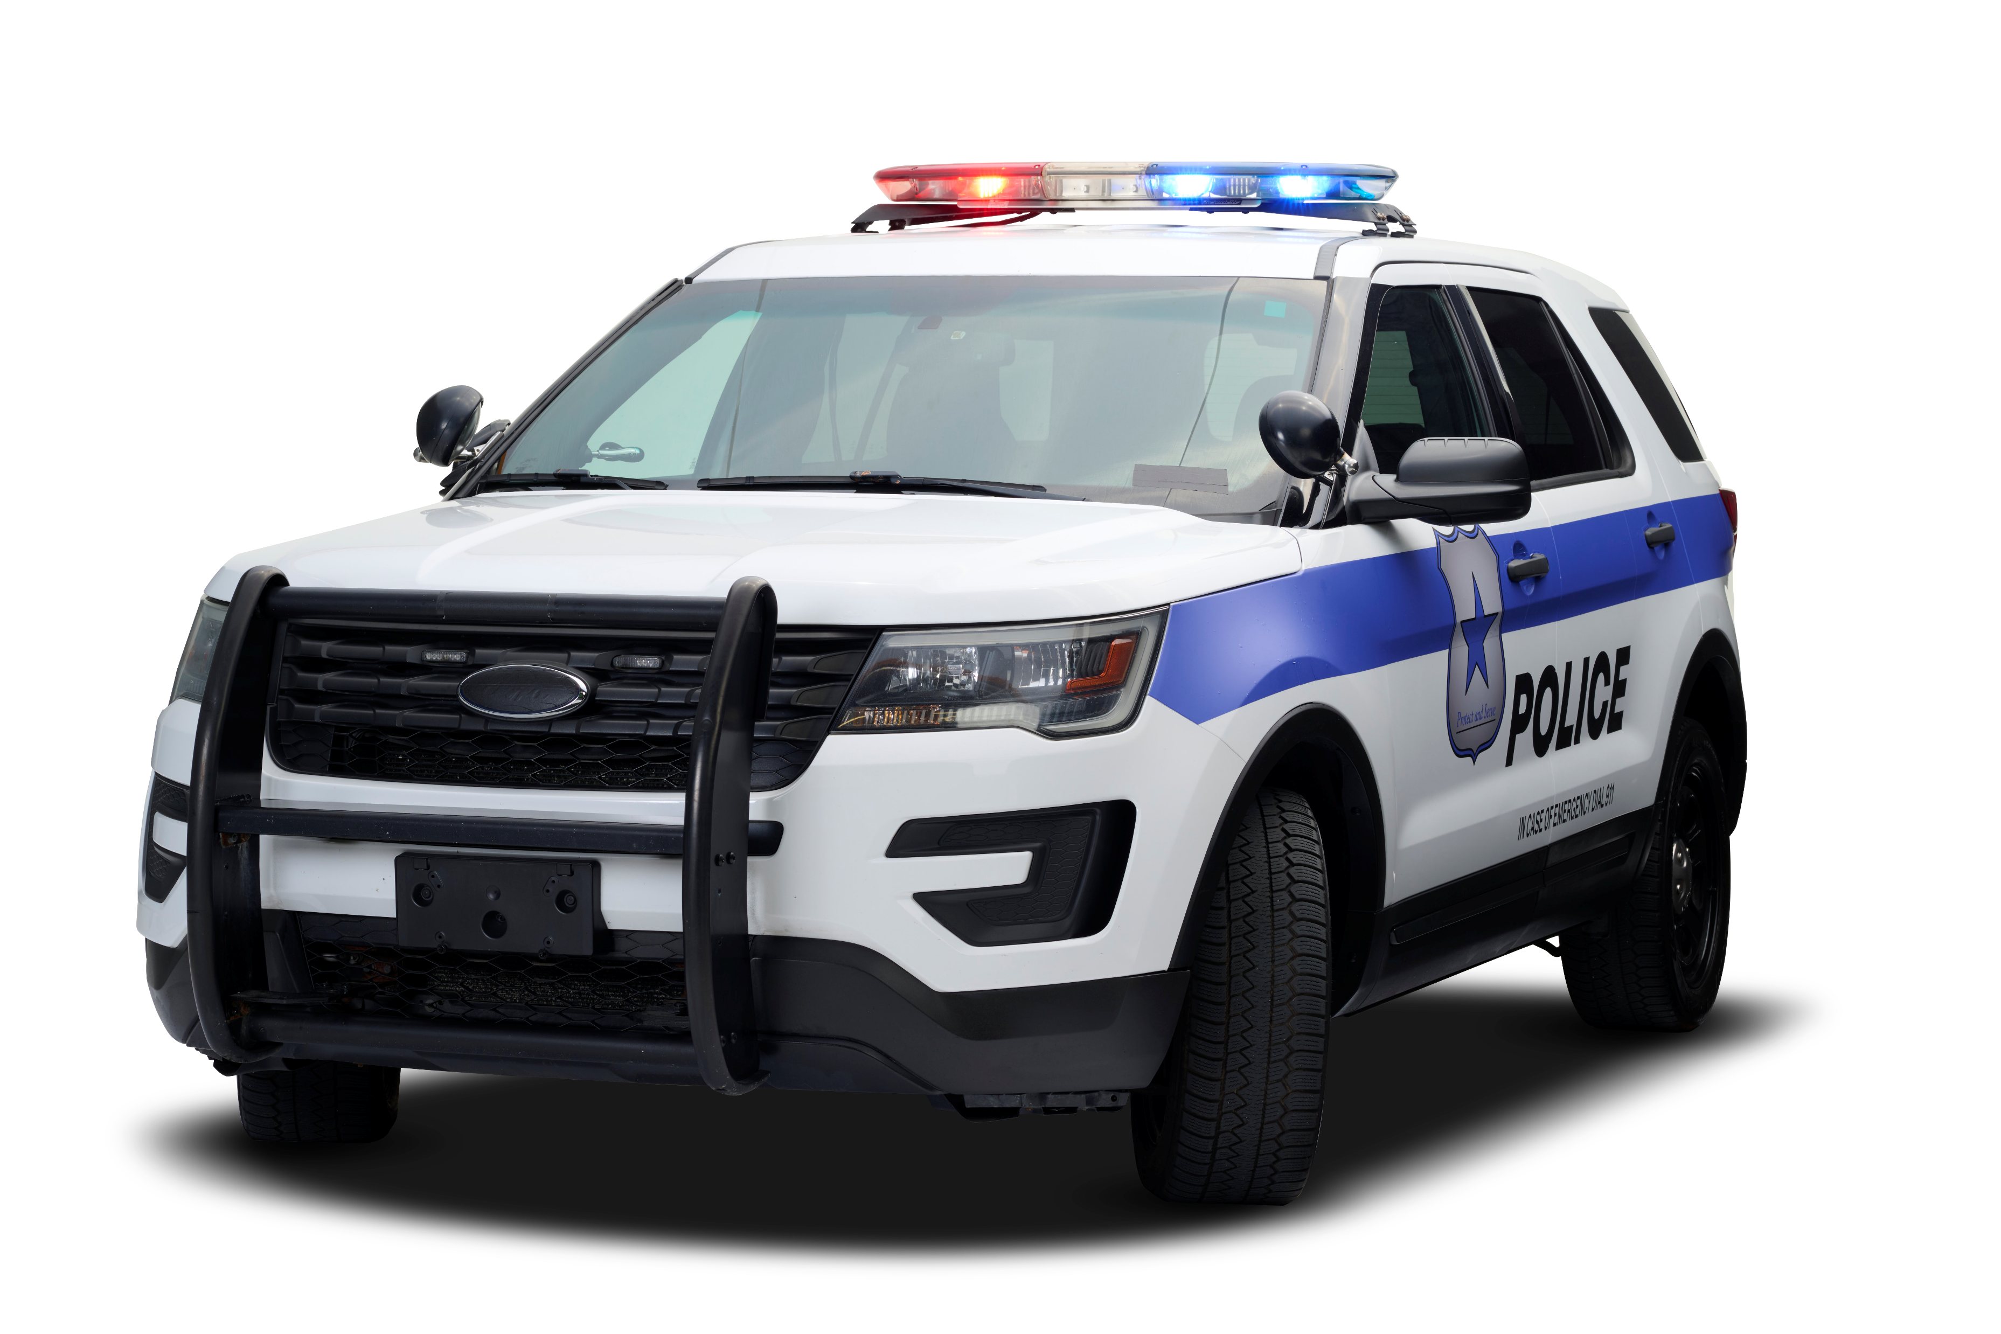
Unit 1 – Introduction to the Oklahoma Graduated Driver License Program
Law Enforcement value GDL
The Oklahoma Graduated Driver License (GDL) program is not just a regulatory framework—it’s a lifeline for public safety and a cornerstone of effective law enforcement.
By phasing in driving privileges through learner’s permits, intermediate licenses, and unrestricted licenses, GDL ensures teen drivers gain critical experience under controlled conditions, significantly reducing the risk of crashes, injuries, and fatalities.
For Law Enforcement, this program is mission-critical because it directly supports your duty to protect communities. GDL’s restrictions—like limiting nighttime driving and passenger numbers—tackle the high-risk scenarios where teen drivers are most likely to falter, meaning fewer crashes for you to respond to, fewer lives lost, and safer roads for everyone.
Studies show GDL programs can reduce teen crash rates by up to 40%, easing the burden on law enforcement resources and allowing you to focus on other pressing priorities.
By enforcing GDL, you’re not just upholding the law—you’re actively saving lives and shaping a generation of responsible drivers.
Law Enforcement:
Embrace the GDL as a powerful ally in your mission to keep Oklahoma’s roads safe.

Slide 11
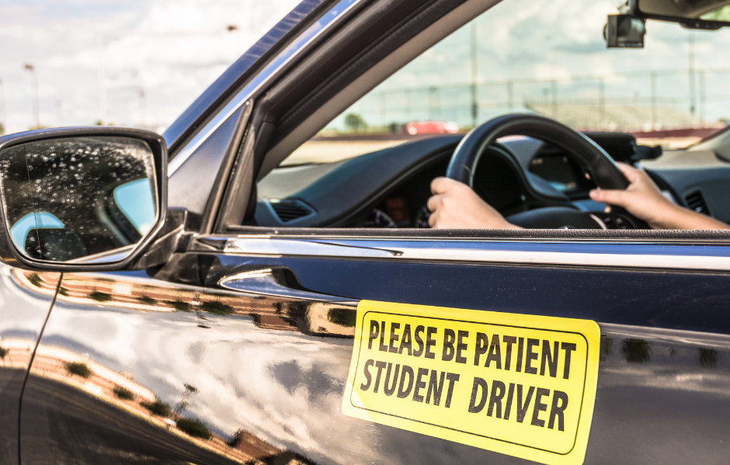
Unit 1 – Introduction to the Oklahoma Graduated Driver License Program
Students value GDL
The Oklahoma Graduated Driver License (GDL) program isn’t just a set of rules—it’s a lifeline for young drivers navigating the thrilling yet treacherous journey of learning to drive.
Imagine stepping into a car for the first time, the open road beckoning with freedom, but also hiding risks that inexperience can’t yet foresee.
The GDL is mission critical because it builds your skills step-by-step, ensuring you gain the confidence and competence to handle real-world dangers.
With restrictions like supervised driving, limited nighttime hours, and passenger limits, it’s designed to protect you while you master the art of safe driving.
Studies show that GDL programs reduce teen crashes by up to 40%, saving countless lives.
This isn’t about holding you back—it’s about empowering you to become a driver who thrives, not just survives.
Students:
Embrace the GDL, because your safety and the safety of everyone on the road, depends on it.

Slide 12
Unit 1 – Introduction to the Oklahoma Graduated Driver License Program
The Four Phases of Oklahoma’s GDL Program
Now that we have reviewed some of the important reasons for you to see the value and importance of Oklahoma’s GDL program, it is now time to introduce you to the four phases of the program.
Those phases are:
No License Phase

Slide 13
Unit 1 – Introduction to the Oklahoma Graduated Driver License Program
The Four Phases of Oklahoma’s GDL Program
Now that we have reviewed some of the important reasons for you to see the value and importance of Oklahoma’s GDL program, it is now time to introduce you to the four phases of the program.
Those phases are:
No License Phase
Learner Permit Phase

Slide 14
Unit 1 – Introduction to the Oklahoma Graduated Driver License Program
The Four Phases of Oklahoma’s GDL Program
Now that we have reviewed some of the important reasons for you to see the value and importance of Oklahoma’s GDL program, it is now time to introduce you to the four phases of the program.
Those phases are:
No License Phase
Learner Permit Phase
Intermediate License Phase

Slide 15
Unit 1 – Introduction to the Oklahoma Graduated Driver License Program
The Four Phases of Oklahoma’s GDL Program
Now that we have reviewed some of the important reasons for you to see the value and importance of Oklahoma’s GDL program, it is now time to introduce you to the four phases of the program.
Those phases are:
No License Phase
Learner Permit Phase
Intermediate License Phase
Unrestricted Class D License Phase

Slide 16
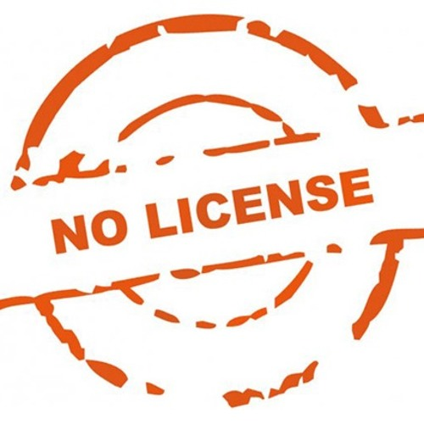
Unit 1 – Introduction to the Oklahoma Graduated Driver License Program
No License Phase
Before moving into the driver’s seat, Oklahoma’s No License phase sets the foundation for a lifetime of safe driving.
This stage, for teens under 15½, is all about preparation and education, igniting a passion for road safety before the keys are even in hand. Teenagers must be at least 15 to enroll in a driver education course, which is a critical first step in learning the rules of the road, understanding traffic signs, and grasping the responsibilities of driving.
This phase isn’t about restrictions—it’s about empowerment through knowledge. By studying and preparing, teens build confidence and a strong sense of accountability, ensuring they’re ready to take on the challenges of the road with respect and caution. It’s the spark that lights the journey to becoming a skilled, responsible driver!

Slide 17
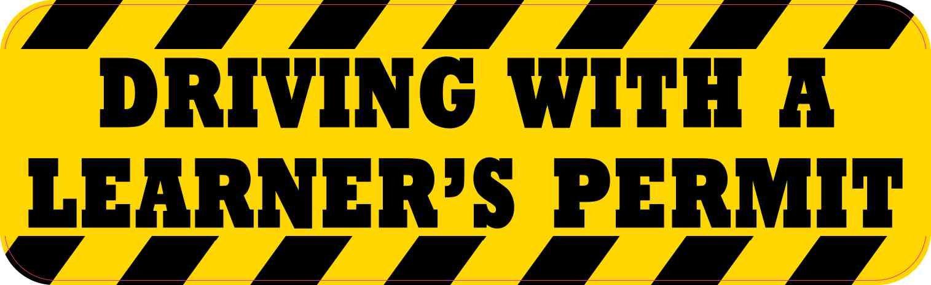
Unit 1 – Introduction to the Oklahoma Graduated Driver License Program
Learner Permit Phase
The Learner Permit phase is where the rubber meets the road—literally! For Oklahoma teens aged 15½ to 16, this phase is an exhilarating leap into hands-on driving under the watchful eye of a licensed adult.
With a learner permit, young drivers can practice behind the wheel, but only with a parent, guardian, or certified instructor, ensuring they gain real-world experience in a safe, controlled environment. They must log at least 50 hours of supervised driving, including 10 hours at night, to hone their skills and build confidence.
This phase requires patience and practice, teaching teens to navigate Oklahoma’s roads while reinforcing the importance of focus and discipline. It’s a transformative step that turns eager learners into capable drivers, ready for greater independence.
Farm Driving Permit
Teens aged 14 to 17 years old, living or employed for compensation on a farm in the state of Oklahoma, will be eligible to apply for a Farm Driving Permit. You can find those details here: https://oklahoma.gov/service/all-pages/farm-driving-permit.html

Slide 18
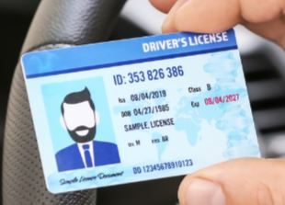
Unit 1 – Introduction to the Oklahoma Graduated Driver License Program
Intermediate License Phase
The Intermediate License phase is a thrilling milestone for Oklahoma’s teen drivers, typically aged 16 to 17, as they earn more freedom while still being guided by smart safeguards.
With this license, young drivers can drive solo during the day and with limited passengers, but nighttime restrictions (10 p.m. to 5 a.m., except for work, school, church, or emergencies) and a ban on non-family passengers for the first six months keep safety first.
This phase carefully balances independence with responsibility, allowing teens to spread their wings while reinforcing the habits that prevent crashes and save lives. It’s a critical bridge to full licensure, where every trip builds experience, sharpens decision-making, and deepens respect for the road’s demands.
INTERMEDIATE

Slide 19
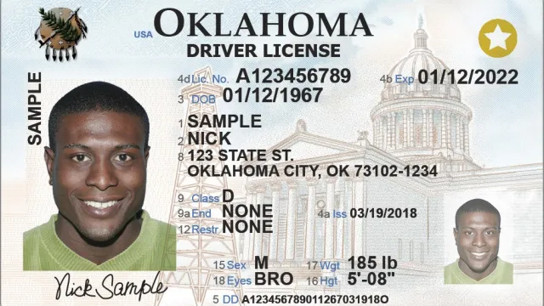
Unit 1 – Introduction to the Oklahoma Graduated Driver License Program
Unrestricted
Class D License Phase
The Unrestricted Class D License is the ultimate achievement in Oklahoma’s GDL program—a badge of trust earned through dedication and skill.
Available at age 17 (or 16½ with driver education and no traffic violations), this phase grants full driving privileges, empowering young drivers to navigate the roads without restrictions.
But with great freedom comes great responsibility! This license signals the young driver is ready to carry forward the lessons of caution, focus, and respect learned in earlier phases.
It’s not just a license; it’s a commitment to safe driving, protecting themselves, their passengers, and everyone on Oklahoma’s roads. This phase celebrates the journey from novice to confident driver, ready to tackle any road with wisdom and care.

Slide 20
Unit 1 – Introduction to the Oklahoma Graduated Driver License Program
The Three Primary Benefits of Oklahoma’s GDL Program
Now that we have gotten an overview of the four phases of Oklahoma’s GDL program, it is now time to introduce you to the three primary benefits of the program. Those benefits are:
Phased Privileges

Slide 21
Unit 1 – Introduction to the Oklahoma Graduated Driver License Program
The Three Primary Benefits of Oklahoma’s GDL Program
Now that we have gotten an overview of the four phases of Oklahoma’s GDL program, it is now time to introduce you to the three primary benefits of the program. Those benefits are:
Phased Privileges
Supervised Practice

Slide 22
Unit 1 – Introduction to the Oklahoma Graduated Driver License Program
The Three Primary Benefits of Oklahoma’s GDL Program
Now that we have gotten an overview of the four phases of Oklahoma’s GDL program, it is now time to introduce you to the three primary benefits of the program. Those benefits are:
Phased Privileges
Supervised Practice
Crash Reduction

Slide 23
Unit 1 – Introduction to the Oklahoma Graduated Driver License Program
Phased Privileges
The Oklahoma Graduated Driver License program is a game-changer for teen drivers, and its phased privileges are at the heart of its success!
By gradually introducing driving responsibilities—starting with a learner’s permit, progressing to an intermediate license with restrictions, and finally earning a full license—the GDL ensures that young drivers build confidence and competence at a pace that matches their development.
This structured approach isn’t about holding teens back; it’s about empowering them to master the road safely. Each phase allows them to tackle new challenges, like nighttime driving or carrying passengers, only when they’re ready.
This thoughtful progression fosters responsible decision-making and equips teens with the skills to navigate Oklahoma’s roads with confidence, protecting them and everyone around them.
Phase 4
Phase 3
Phase 2
Phase 1

Slide 24
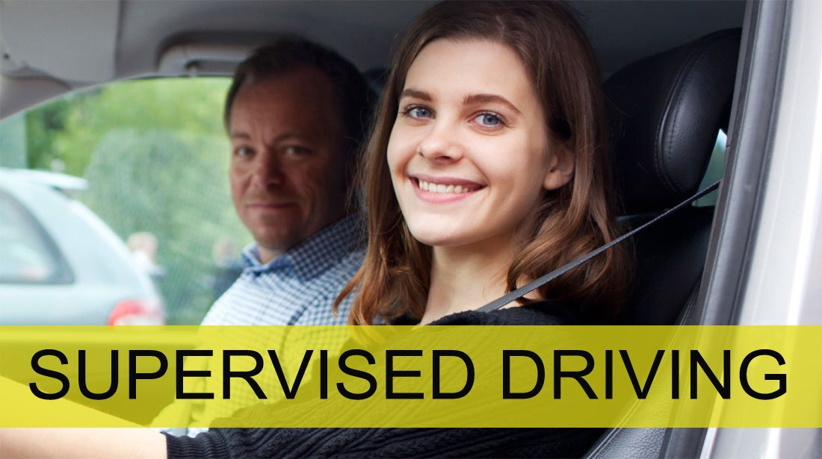
Unit 1 – Introduction to the Oklahoma Graduated Driver License Program
Supervised Practice
Supervised practice is an important piece of the Oklahoma GDL program, transforming nervous novices into skilled drivers through real-world experience under watchful eyes.
Requiring teens to log hours of supervised driving with a parent or guardian isn’t just a rule—it’s a lifeline.
This hands-on guidance allows young drivers to encounter diverse road conditions, from rural Oklahoma highways to bustling city streets, while having an experienced mentor to correct mistakes and offer wisdom. It’s a chance to learn the nuances of defensive driving, anticipate hazards, and build muscle memory for safe habits.
By prioritizing supervised practice, the GDL program ensures that teens aren’t thrown into the driver’s seat unprepared, giving them the tools and the time to become confident, capable drivers who prioritize safety.

Slide 25
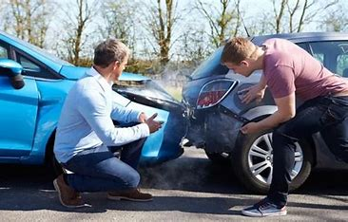
Unit 1 – Introduction to the Oklahoma Graduated Driver License Program
Crash Reduction
The Oklahoma GDL program is a proven lifesaver, slashing crash rates among teen drivers and making our roads safer for everyone.
Statistics show that GDL systems significantly reduce the risk of collisions for young drivers, who are often vulnerable due to inexperience.
By enforcing restrictions like limiting nighttime driving and passenger numbers, the program minimizes high-risk scenarios where crashes are most likely to occur.
This isn’t just about numbers—it’s about saving lives, sparing families heartbreak, and giving teens the chance to grow into adulthood safely.
The GDL’s success in crash reduction is a testament to its power to protect our youth, ensuring they can enjoy the freedom of driving without the devastating consequences of preventable collisions.

Slide 26
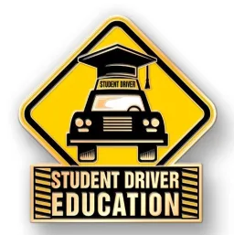
Unit 1 – Introduction to the Oklahoma Graduated Driver License Program
The Role of Driver Education in Oklahoma’s GDL Program.
Driver education is the centerpiece of Oklahoma’s Graduated Driver License (GDL) program, equipping young drivers with the knowledge, skills, and judgment needed to navigate the road safely.
By blending classroom instruction with hands-on practice, driver education instills critical habits—like defensive driving, hazard awareness, and adherence to traffic laws—that reduce the risk of crashes, which are a leading cause of death for teens.
Under the GDL framework, this education is not a one-time event but a structured journey, guiding novices through progressive stages of supervised driving, restricted privileges, and eventual full licensure.
Passionate, engaging instruction empowers teens to make responsible choices, fostering a culture of safety that protects not just them but every Oklahoman sharing the road. It’s more than a program—it’s a lifeline for our youth and our communities.

Slide 27
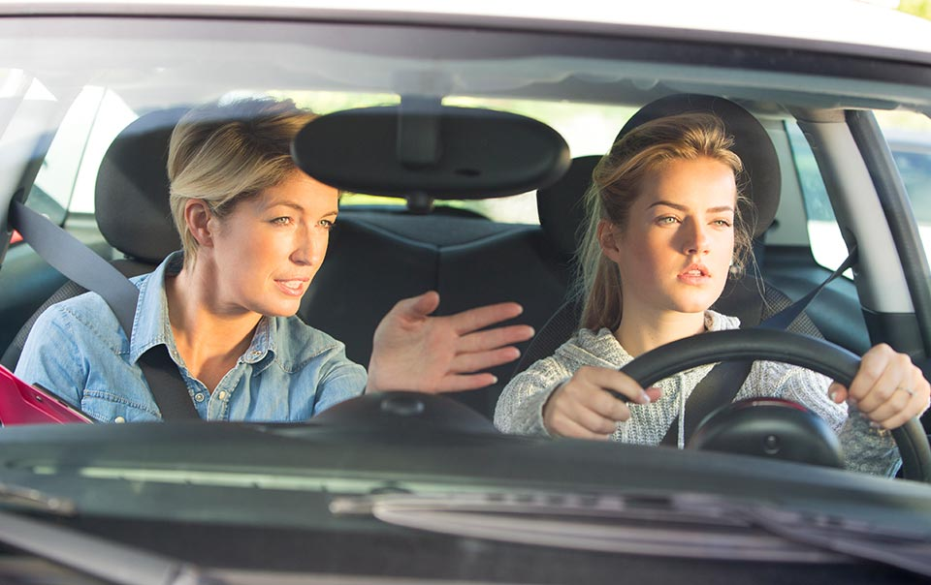
Unit 1 – Introduction to the Oklahoma Graduated Driver License Program
Parental Responsibilities in Oklahoma’s GDL Program
Parents play a pivotal role in the success of Oklahoma’s Graduated Driver License (GDL) program, serving as the cornerstone of their teen’s journey to becoming a safe, responsible driver.
Beyond simply signing forms, parents are entrusted with actively guiding their teens through each GDL phase, ensuring compliance with restrictions like nighttime driving limits and passenger rules.
This responsibility demands hands-on involvement—supervising practice drives, modeling safe driving habits, and setting clear expectations for road behavior.
By engaging in open conversations about the risks of distracted driving, speeding, and impaired driving, parents can instill lifelong skills that prioritize safety. Their commitment not only reinforces the GDL’s structure but also protects their teens and others on the road, shaping a generation of confident, cautious drivers.

Slide 28
Unit 1 – Introduction to the Oklahoma Graduated Driver License Program
Supplemental Resources For Your Benefit
Unit 1 Summary Handout – Printing out this handout and having it available for review will assist you when you complete the review questions for Unit 1.
Oklahoma Teen Driving Page - https://oklahoma.gov/service/popular-services/teen-driving.html
Graduated Licensing Calculator - https://www.iihs.org/research-areas/teenagers/gdl-calculator
Farm Driving Permit - https://oklahoma.gov/service/all-pages/farm-driving-permit.html

Slide 29
Unit 1 – Introduction to the Oklahoma Graduated Driver License Program
This concludes Unit 1.
This concludes our presentation: Introduction to the Oklahoma Graduated Driver License (GDL) Program.
You should now have a solid understanding of the fundamentals of this program.
Please complete the review questions for Unit 1.
Click for Unit 1 Quiz

